Slide 1

Department
of
Computer Engineering
CEN 263
Digital Design
Autumn 2024
Lecture 7

Slide 2
Week 7 Outlines
Finite State Machines (FSMs)
FSM Examples
SystemVerilog modelling

Slide 3
What are FSMs?

Slide 4
What are FSMs?
Finite State Machines (FSMs) are fundamental models of computation used extensively in digital design.
They are used to design systems where the output depends on a sequence of events or states.
FSMs are a crucial topic in digital design because they integrate sequential logic (flip-flops, latches) with combinational logic.

Slide 5
What are FSMs?
An FSM is a model of a system with:
States: Distinct conditions or situations the system can be in.
Transitions: Rules that govern how the system moves from one state to another.
Inputs: Signals or data that affect state transitions.
Outputs: Signals or data produced based on states (and sometimes inputs).
Reset Mechanism

Slide 6
Types of FSMs
FSMs are two types: Moore Machine and Mealy Machine
a) Moore Machine
The output depends only on the current state.
Outputs change only when the state changes.
Simpler to design but sometimes less flexible.
Example: Traffic Light Controller
States: Red, Green, Yellow.
Outputs: Lights (Red = ON, Green = OFF, Yellow = OFF, etc.).

Slide 7
Types of FSMs
FSMs are two types: Moore Machine and Mealy Machine
b) Mealy Machine
The output depends on both the current state and inputs.
Outputs can change during state transitions.
More compact in implementation but potentially more complex.
Example: Door Lock Controller
States: Locked, Unlocked.
Inputs: Correct/Incorrect Password.
Outputs: Door state and buzzer signal.

Slide 8
FSM Components
An FSM design can be broken into the following key elements:
State Diagram
A graphical representation of states and transitions.
Nodes represent states; arrows represent transitions.
Conditions for transitions are labeled on the arrows.
State Table
A tabular form listing states, inputs, next states, and outputs.
Useful for systematic FSM implementation.

Slide 9
FSM Components
An FSM design can be broken into the following key elements:
Transition Logic
The combinational logic that dictates how states change based on inputs.
Flip-Flops or Memory Elements
Used to store the current state.

Slide 10
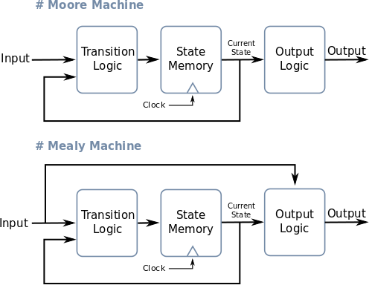
FSM Types

Slide 11
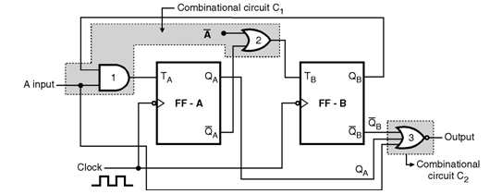
FSM Types

Slide 12

FSM Types

Slide 13
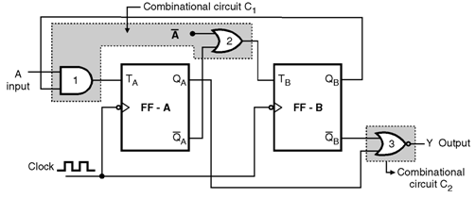
FSM Types

Slide 14

FSM Types

Slide 15
3-bit up counter: with T flip flops
Draw a state diagram
Draw a state-transition table
Encode the next-state functions Minimize the logic using k-maps
Implement the design

Slide 16
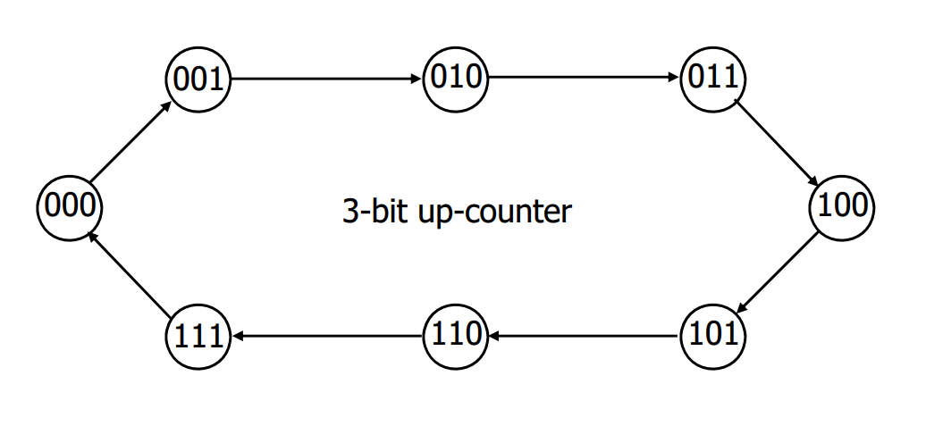
3-bit up counter: with T flip flops
Draw a state diagram
Draw a state-transition table
Encode the next-state functions Minimize the logic using k-maps
Implement the design

Slide 17
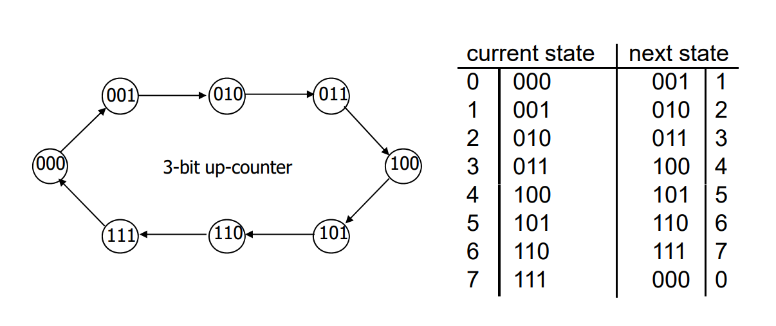
3-bit up counter: with T flip flops
Draw a state diagram
Draw a state-transition table
Encode the next-state functions Minimize the logic using k-maps
Implement the design

Slide 18
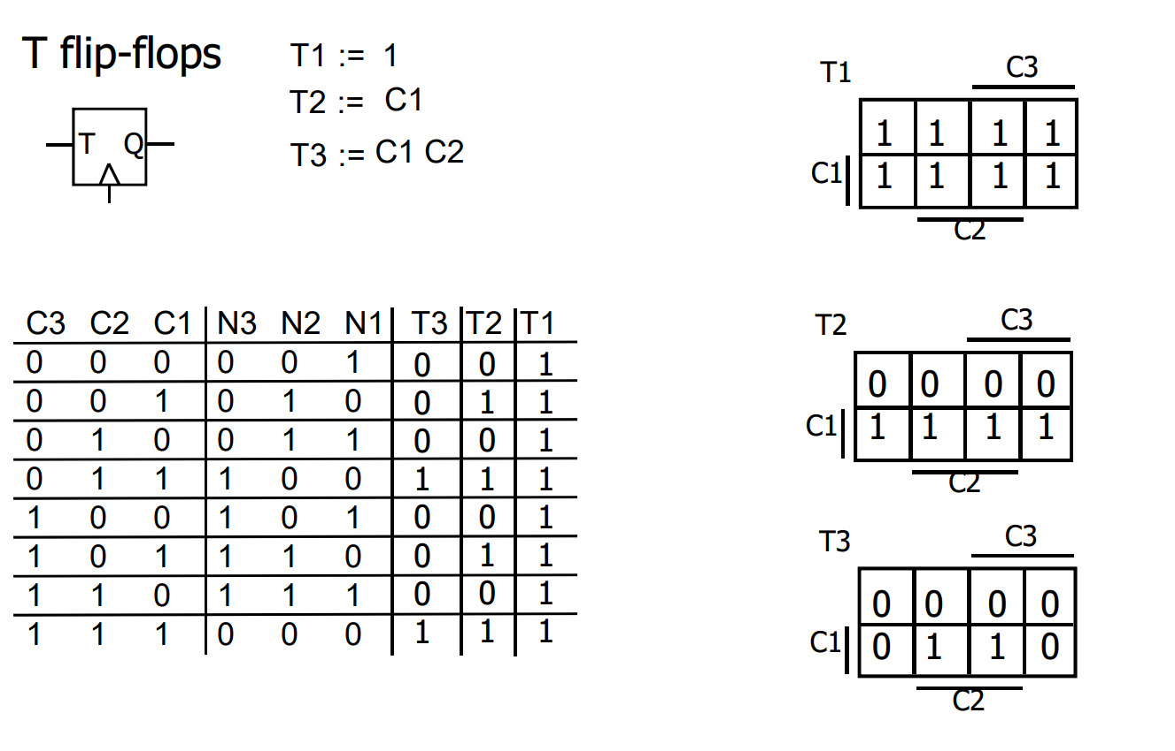
3-bit up counter: with T flip flops
Encode the next-state functions Minimize the logic using k-maps

Slide 19
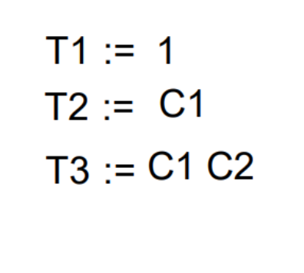
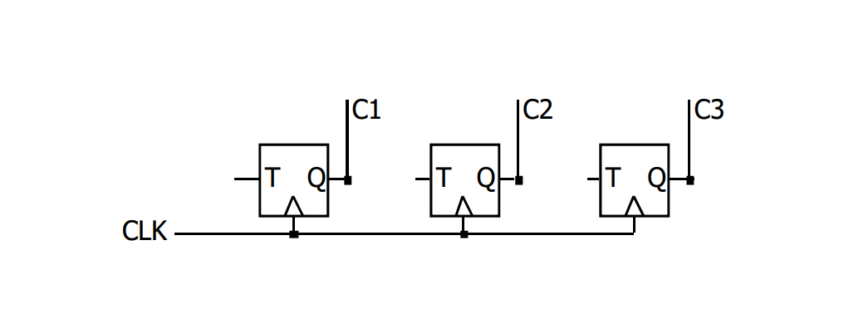
3-bit up counter: with T flip flops
Implement the design

Slide 20
A 5-state counter with D flip flops
Counter repeats 5 states in sequence
Sequence is 000, 010, 011, 101, 110, 000
Step 1: State diagram
Step 2: State transition table
(use D flip-flops)

Slide 21
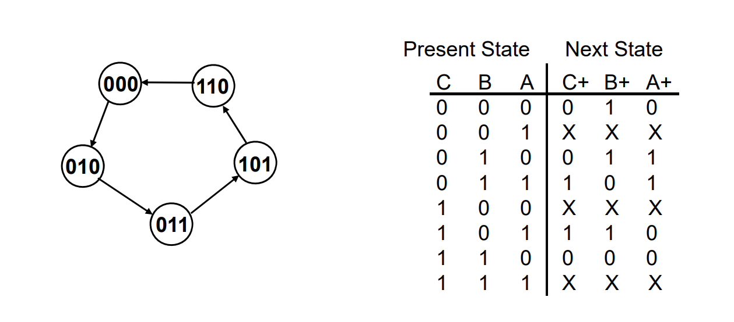
A 5-state counter with D flip flops
Counter repeats 5 states in sequence
Sequence is 000, 010, 011, 101, 110, 000
Step 2: State transition table Assume D flip-flops
Step 1: State diagram

Slide 22
A 5-state counter with D flip flops
Counter repeats 5 states in sequence
Sequence is 000, 010, 011, 101, 110, 000
Step 3: Encode the next state functions

Slide 23
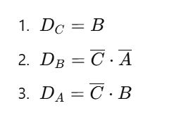
A 5-state counter with D flip flops
Counter repeats 5 states in sequence
Sequence is 000, 010, 011, 101, 110, 000
Step 4: Implement the design

Slide 24
A 5-state counter with D flip flops
Counter repeats 5 states in sequence
Sequence is 000, 010, 011, 101, 110, 000
Is this counter get stuck in somewhere?

Slide 25
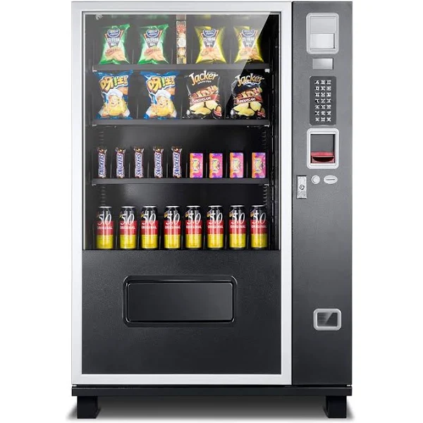
Example: Vending Machine
Problem Description:
Create a state diagram for a vending machine that dispenses candy when the correct amount of money is inserted.

Slide 26
Example: Vending Machine
Step 1: Identify the States
The first step in creating a state diagram is to identify the states that the system can be in. For a vending machine, some possible states might include:
Idle: waiting for user input
Money inserted: user has inserted money but hasn’t made a selection
Candy selected: user has selected a candy but hasn’t yet received it
Candy dispensed: user has received the selected candy

Slide 27
Example: Vending Machine
Step 2: Identify the Events and Transitions
The next step is to identify the events that can trigger transitions between the states. In this case, the possible events might include:
Money inserted
Candy selected
Candy dispensed

Slide 28
Example: Vending Machine
Based on these events, we can identify the following transitions:
Idle -> Money inserted: when the user inserts money
Money inserted -> Candy selected: when the user selects a candy
Candy selected -> Candy dispensed: when the machine dispenses the selected candy
Candy dispensed -> Idle: when the user takes the candy and the machine is ready for the next transaction

Slide 29
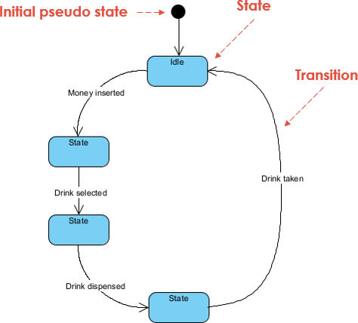




Example: Vending Machine
Step 3: Draw the State Diagram
Using the states and transitions
we’ve identified,
we can draw the state diagram:

Slide 30
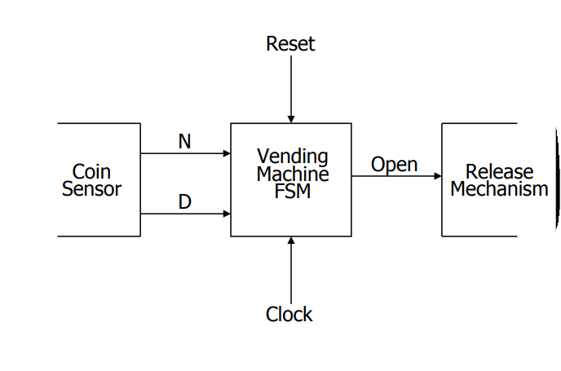
Example: Vending Machine
15 cents for a cup of coffee
Only 5 (N) and 10 (D) cents are valid
Doesn’t provide any change

Slide 31
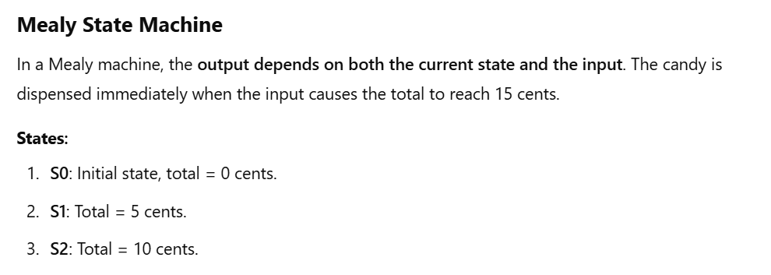
Example: Vending Machine: Mealy machine

Slide 32
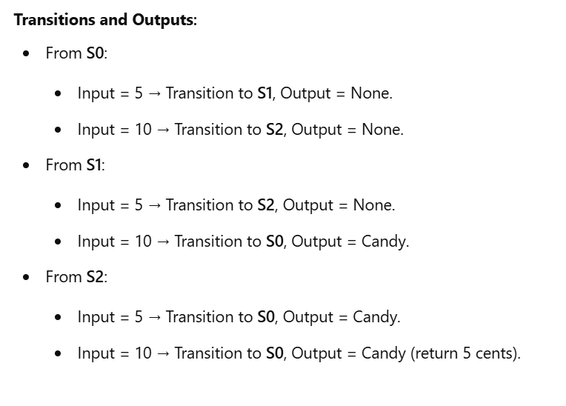
Example: Vending Machine: Mealy machine

Slide 33
Example: Vending Machine: Mealy machine
How to generate the state table and state diagram?

Slide 34
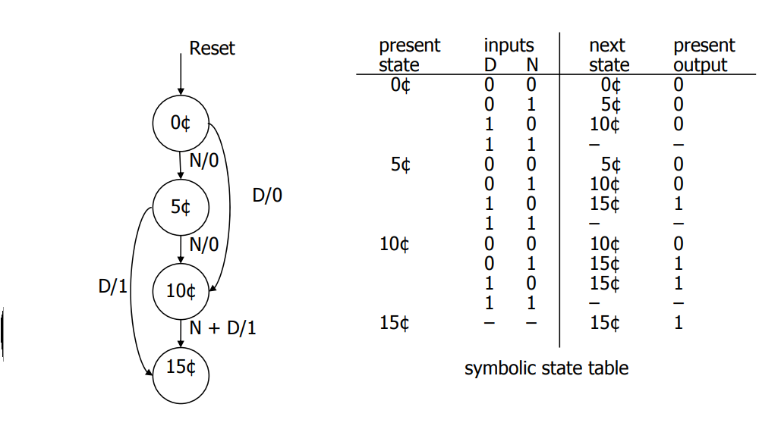
Example: Vending Machine: Mealy machine

Slide 35
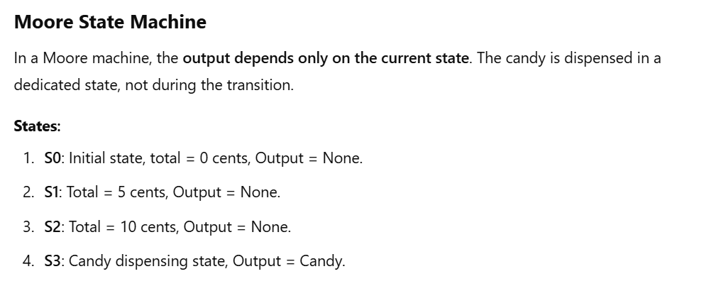
Example: Vending Machine: Moore machine

Slide 36
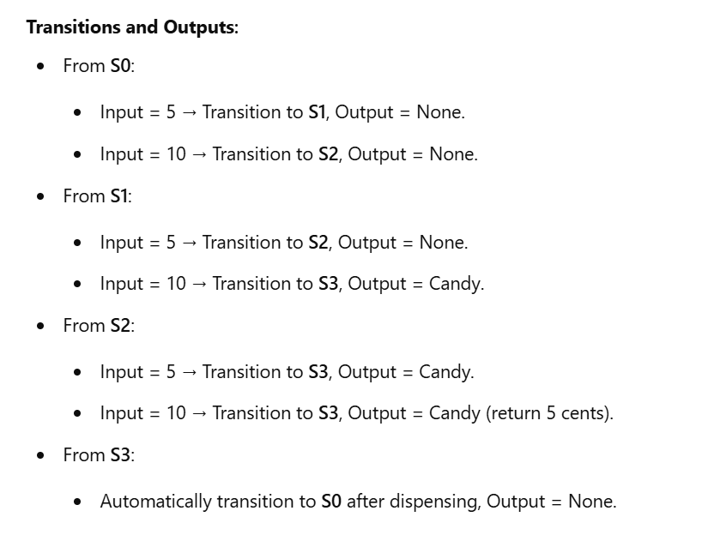
Example: Vending Machine: Moore machine

Slide 37
Example: Vending Machine: Moore machine
How to generate the state table and state diagram?

Slide 38
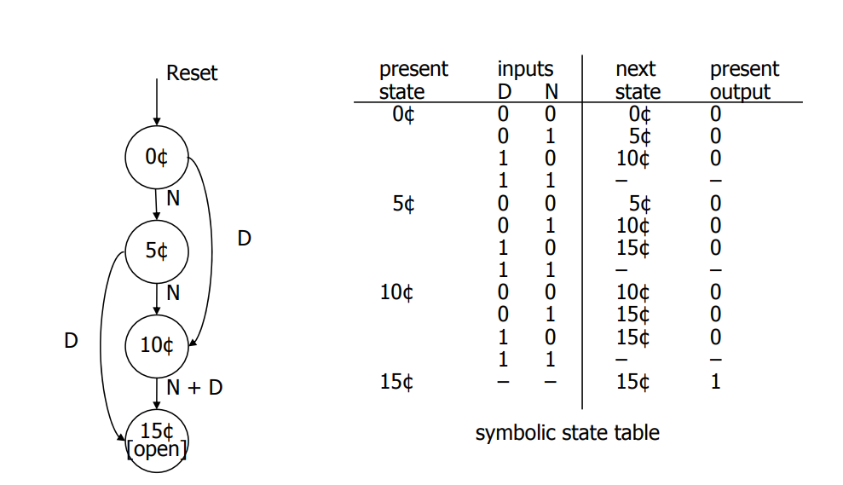
Example: Vending Machine: Moore machine

Slide 39
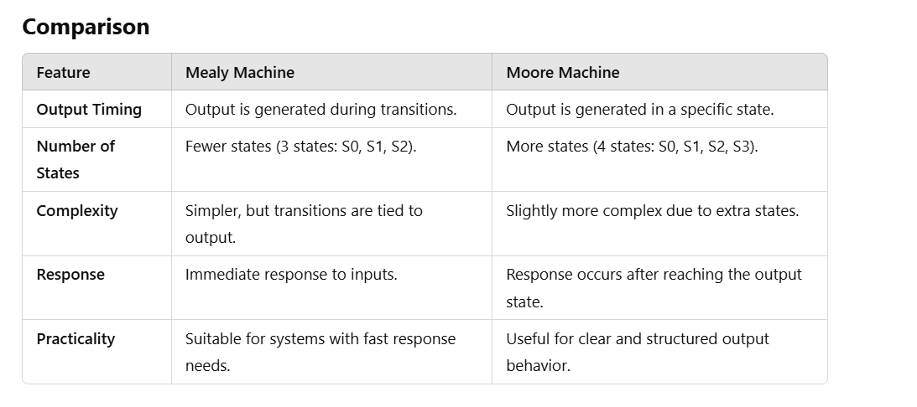
Example: Vending Machine: Mealy vs Moore machines

Slide 40
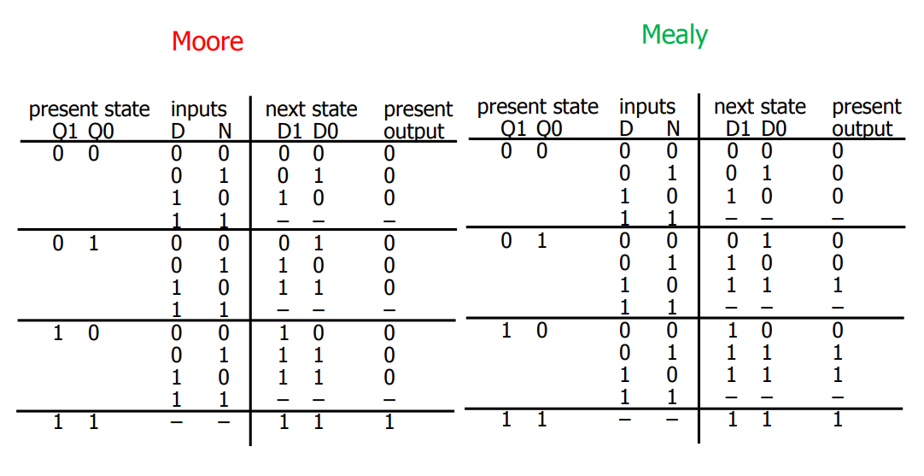
Example: Vending Machine: Mealy vs Moore machines

Slide 41
Example: Vending Machine: Moore machine
How to draw K-Maps?

Slide 42
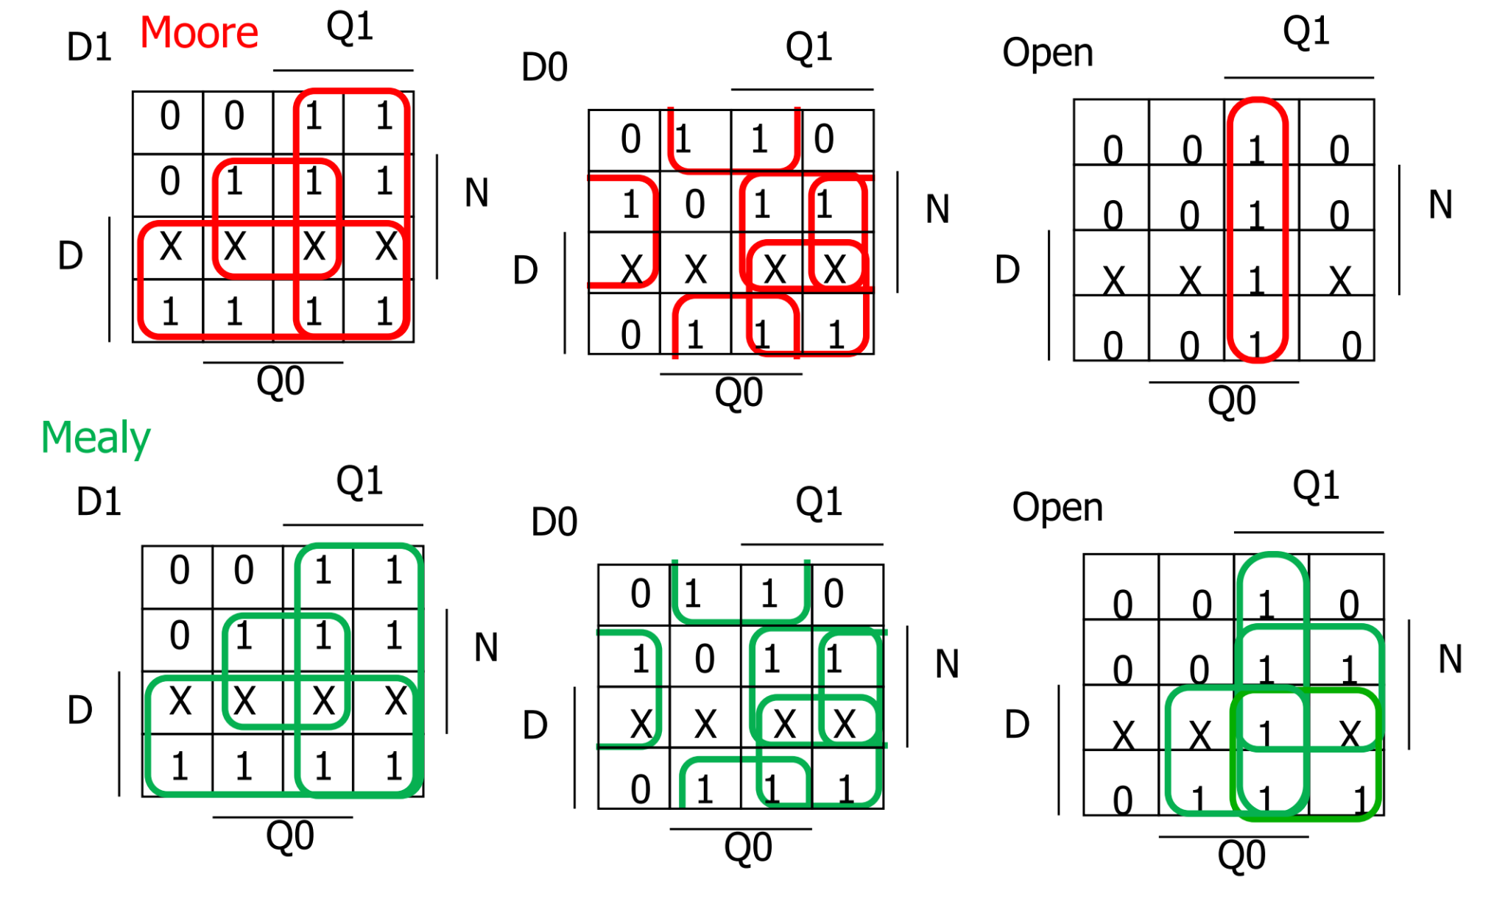
Example: Vending Machine: Logic minimization

Slide 43
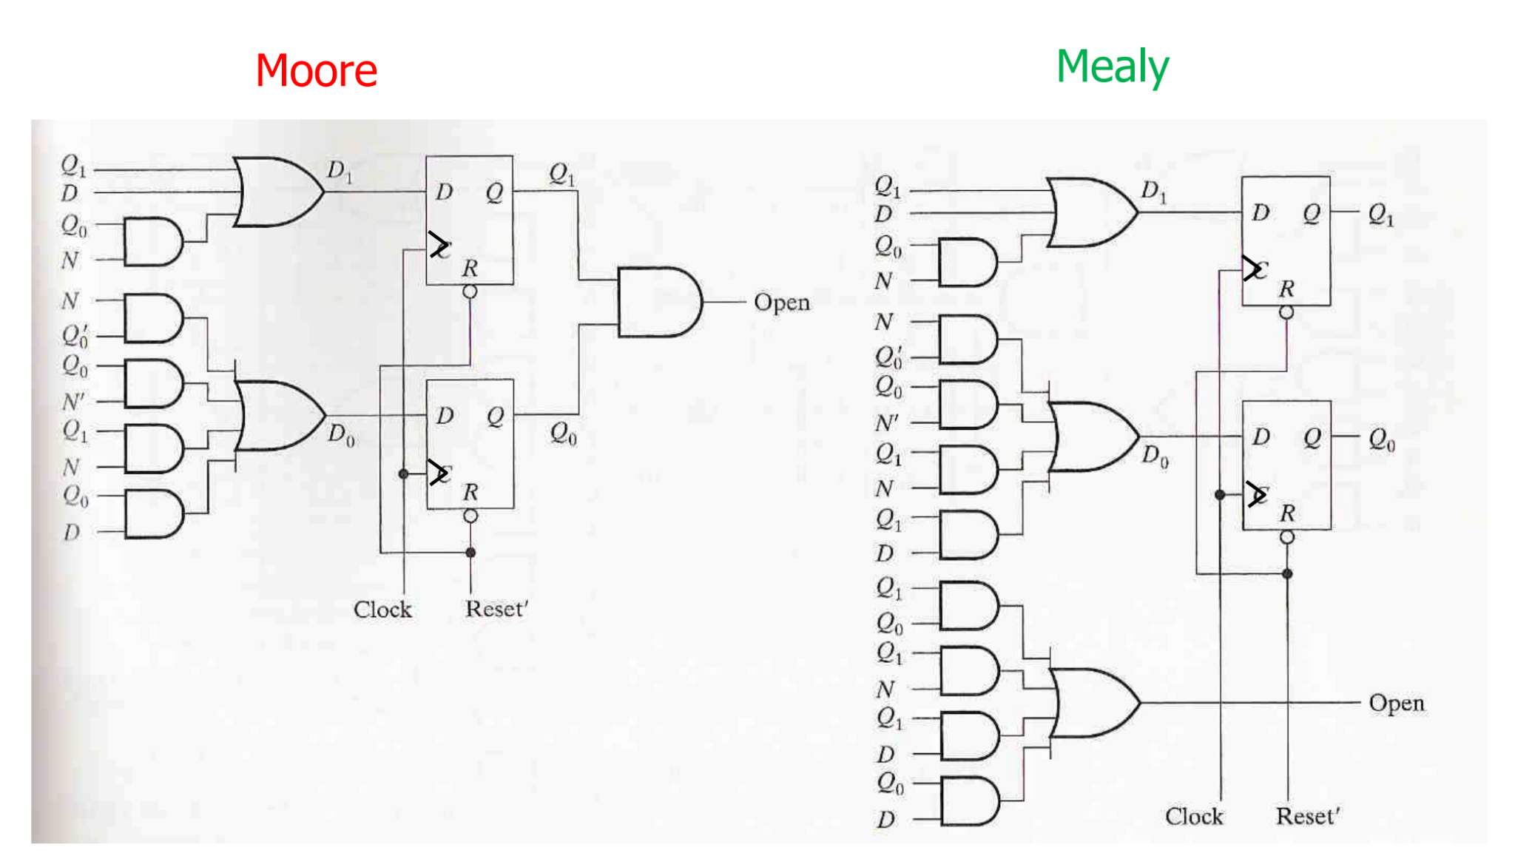
Example: Vending Machine: D FF

Slide 44
Example: Vending Machine: Mealy machine - SystemVerilog
How to write design code of vending machine with SystemVerilog?

Slide 45
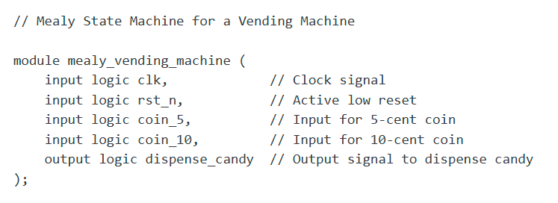
Example: Vending Machine: Mealy machine - SystemVerilog

Slide 46
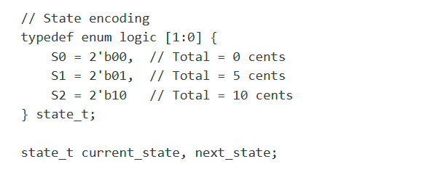
Example: Vending Machine: Mealy machine - SystemVerilog

Slide 47
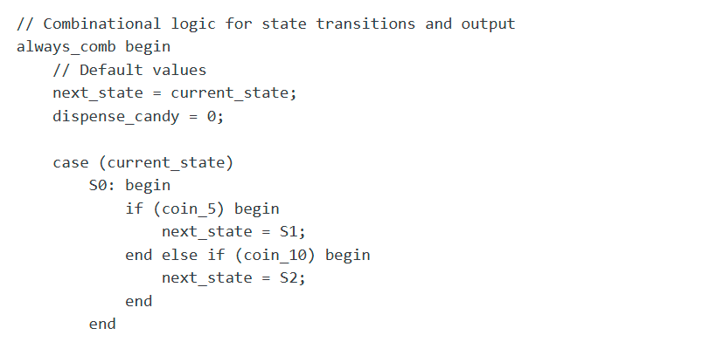
Example: Vending Machine: Mealy machine - SystemVerilog

Slide 48
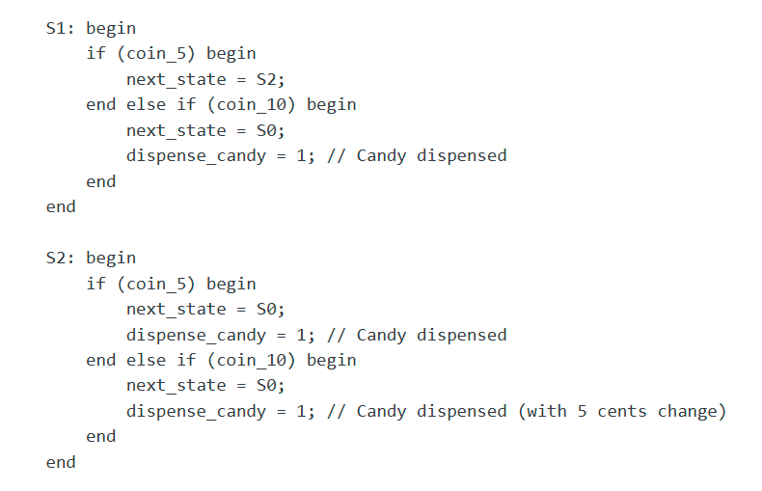
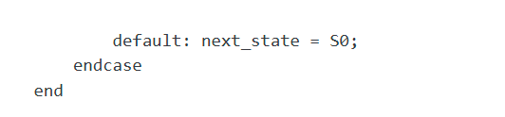
Example: Vending Machine: Mealy machine - SystemVerilog

Slide 49
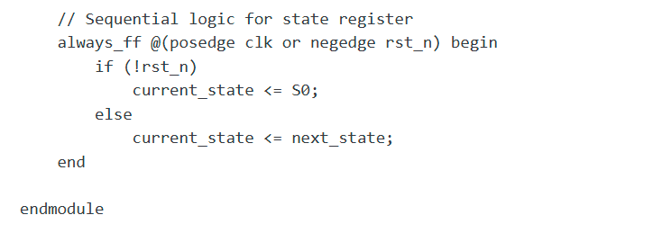
Example: Vending Machine: Mealy machine - SystemVerilog

Slide 50
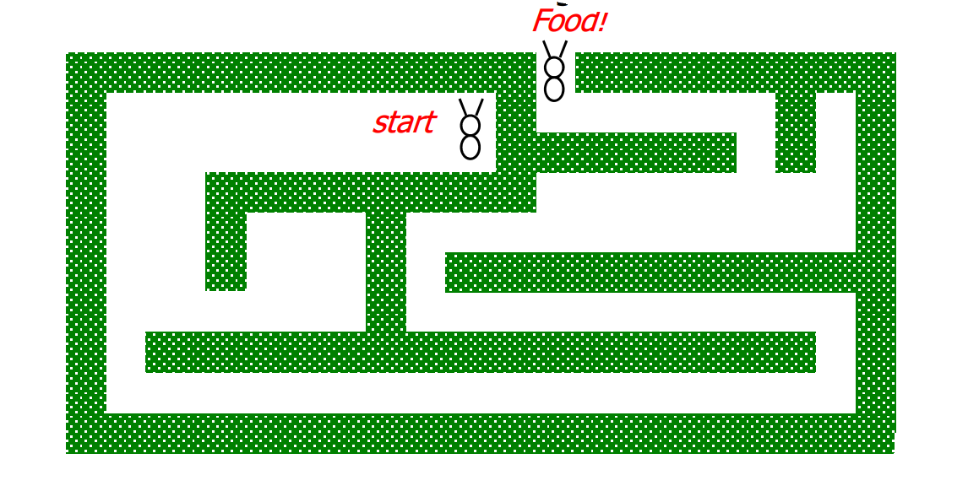
Assignment!
Design a Robotic Ant’s Brain to Navigate a Virtual Maze
Objective:
Design a digital system that represents the "brain" of a robotic ant navigating a virtual maze. The goal is for the ant to locate food placed at a specific location in the maze.

Slide 51
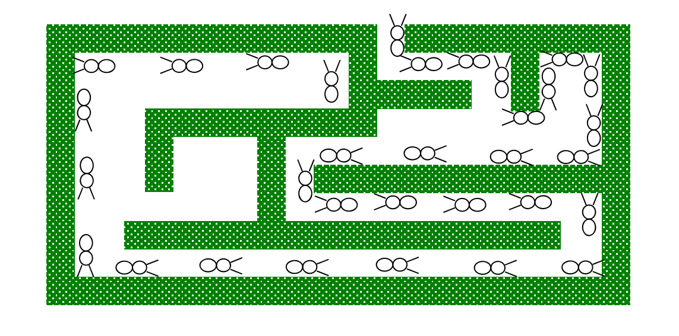
Assignment! Design a Robotic Ant’s Brain to Navigate a Virtual Maze
Robot ant specifics
Sensors: L and R antennae, 1 if touching wall
Actuators: F - forward step, TL/TR - turn left/right
Goal: find way out of find way out of maze to get to food maze to get to food. Strategy: keep the wall on the right

Slide 52
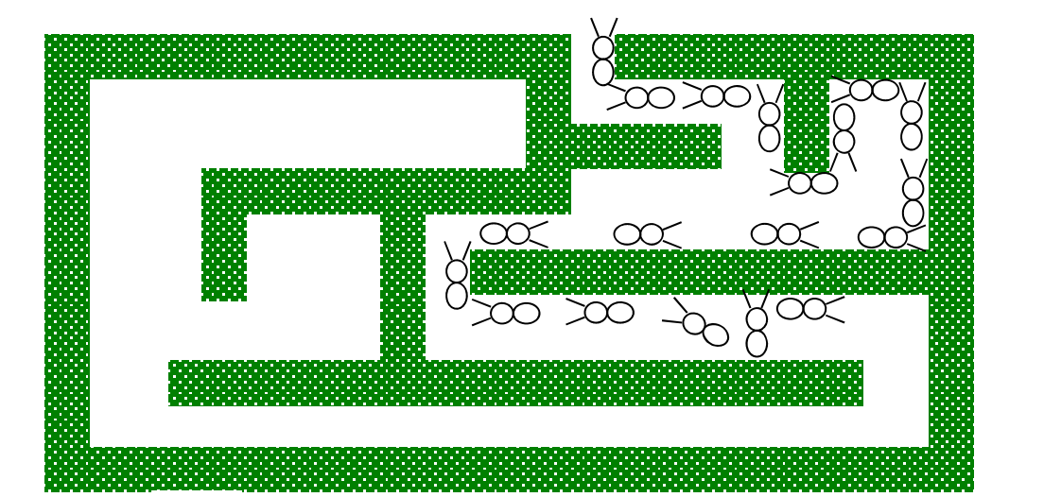
Assignment! Design a Robotic Ant’s Brain to Navigate a Virtual Maze
Example: ant brain (special case 1)
Left (L) Antenna touching the wall

Slide 53
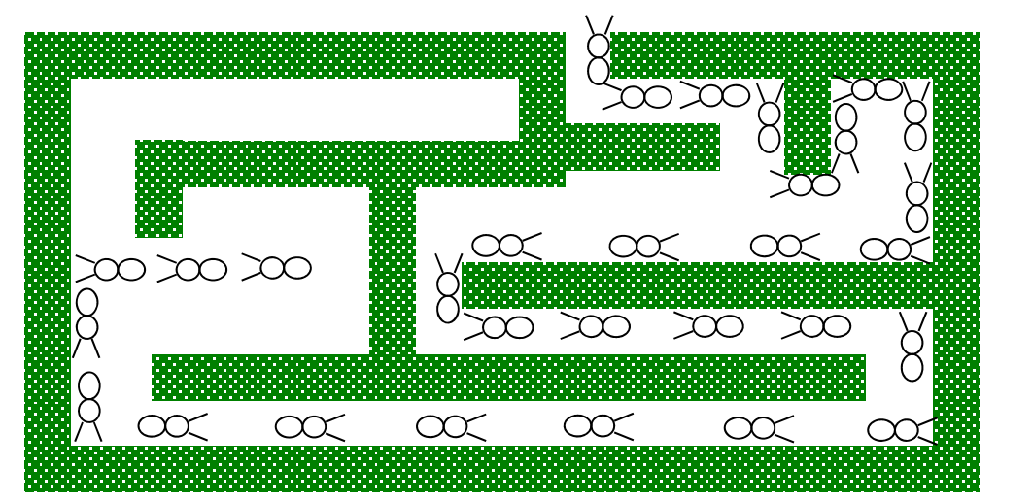
Assignment! Design a Robotic Ant’s Brain to Navigate a Virtual Maze
Example: ant brain (special case 2)
Ant Lost

Slide 54
Assignment! Design a Robotic Ant’s Brain to Navigate a Virtual Maze
Design the ant-brain FSM
What are the states?
Draw state diagram.

Slide 55
End of Week 7

